Slide 1
组词练习

Slide 2
名词+名词= 新字
Thing 1 Thing 2
春 + 天 = 春天
大
http://cf.ltkcdn.net/kids/images/std/160767-425x270-spring-clipart-children-thumb2.jpg
http://bestclipartblog.com/21-spring-flowers-clip-art.html/spring-flowers-clip-art-7
http://www.gamesparks.com/wp-content/uploads/2013/07/the-cloud-300x213.jpg

Slide 3
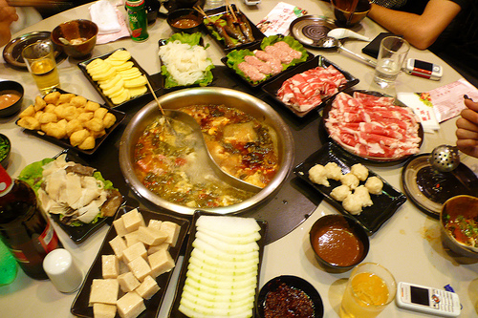
火 + 锅
=
火锅
http://blog.asiahotels.com/wp-content/uploads/2009/12/hotpot.jpg
http://cdn.graphicsfactory.com/clip-art/image_files/image/1/1312301-cowboys_4162007-096.gif
http://www.clker.com/cliparts/R/W/l/Q/v/B/steal-pot-hi.png

Slide 4
风 + 筝 = 风筝
http://blog.austinkids.org/tag/kite/
http://environment.phillipmartin.info/science_wind.gif

Slide 5
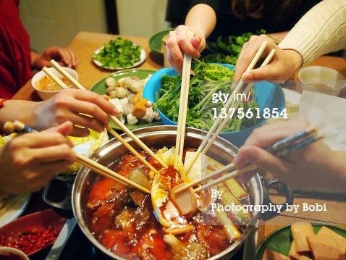
动词 + 名词
吃
火锅
吃火锅
http://www.gettyimages.com/detail/photo/friends-in-house-party-to-eat-hot-pot-royalty-free-image/137561854

Slide 6
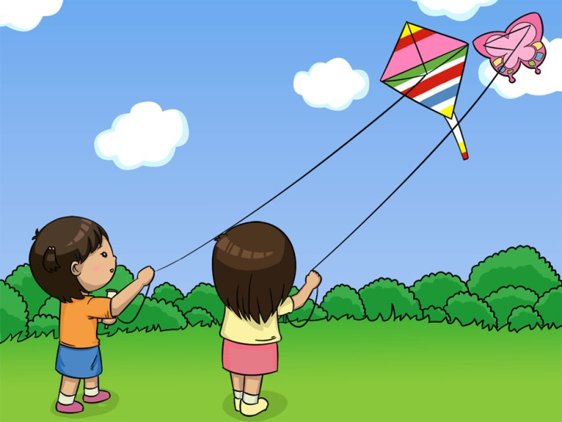
放
风筝
+
放风筝
http://www.spacearkstudios.com/portfolio/illustration/children-illustration-kites-flying-high-into-the-clouds/

